Slide 1
Heart Disease Prediction Using Machine Learning
Analyzing and Predicting Heart Health Outcomes
Hemanth karukola
(501336456)
M.Engg in Biomedical Engineering

Slide 2
01
02
03
Introduction
Dataset and Methodology
Exploratory Data Analysis (EDA)
04
05
06
Model Development and Performance
Insights and Applications
Conclusion and Future Directions
Overview of heart disease as a global health challenge and the need for predictive modeling.
Explanation of the dataset, preprocessing steps, and the machine learning workflow used.
Key patterns and correlations identified in the dataset to guide feature selection.
Models implemented, evaluation metrics, and performance comparison across algorithms.
Significant predictors identified and potential real-world applications of the model.
Summary of findings, model implications, and next steps for improving and deploying the solution.

Slide 3
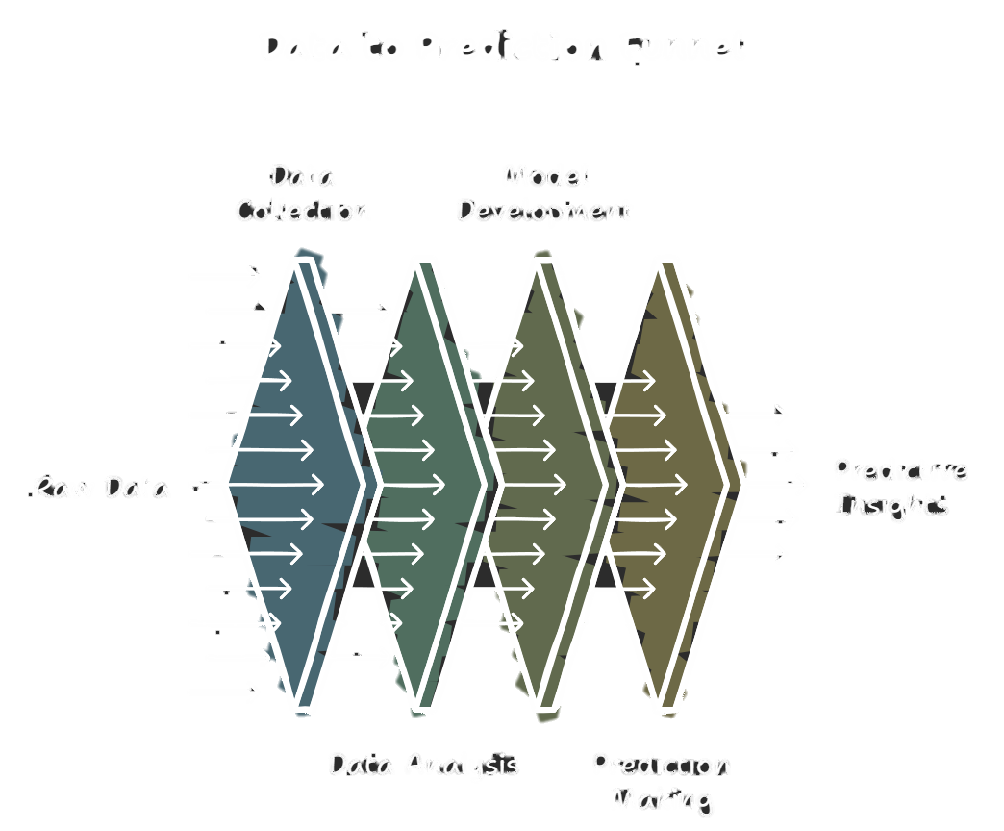
Introduction
Early detection can save lives and reduce healthcare costs.
Objective of the Study:
Use a dataset of clinical parameters to build a predictive model for heart disease.
Explore which features are most influential in determining heart disease risk.

Slide 4

Dataset Overview
Size: 303 records with 14 features.
each column likely represents in the dataset:
age: Age of the patient in years.
sex: Gender (1 = male, 0 = female).
cp: Chest pain type (0 = typical angina, 1 = atypical angina, 2 = non-anginal pain, 3 = asymptomatic).
trestbps: Resting blood pressure (in mm Hg).
chol: Serum cholesterol (in mg/dL).
fbs: Fasting blood sugar > 120 mg/dL (1 = true, 0 = false).
Restecg: Resting electrocardiographic results (0 = normal, 1 = ST-T wave abnormality, 2 = showing probable or definite left ventricular hypertrophy).
thalach: Maximum heart rate achieved.
exang: Exercise-induced angina (1 = yes, 0 = no).
oldpeak: ST depression induced by exercise relative to rest.
slope: Slope of the peak exercise ST segment (0 = upsloping, 1 = flat, 2 = downsloping).
ca: Number of major vessels (0-3) colored by fluoroscopy.
thal: Thalassemia (1 = normal, 2 = fixed defect, 3 = reversible defect).
target: Target variable (1 = disease, 0 = no disease).

Slide 5
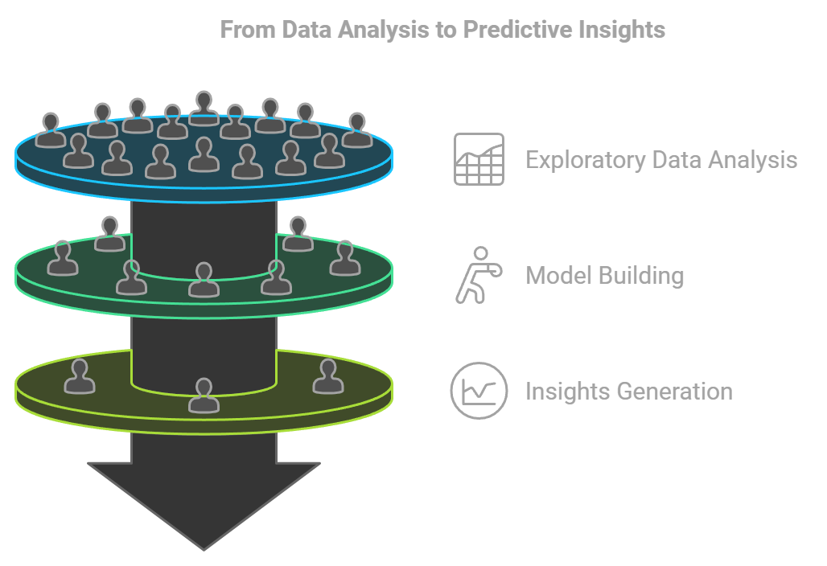
Process
Exploratory Data Analysis (EDA):
Analyzed the distribution of variables to understand their characteristics.
Examined correlations between features to identify relationships.
Visualized key relationships, such as age vs. cholesterol levels, using scatter plots and other charts.
Model Building:
Developed classification models, including Logistic Regression, Decision Trees, Random Forest, and Neural Networks, to predict the likelihood of heart disease.
Evaluated model performance using metrics like accuracy, precision, recall, F1-score, and ROC-AUC for a comprehensive assessment.
Insights:
Identified the most significant features contributing to heart disease prediction.
Observed trends, such as the influence of cholesterol levels and maximum heart rate, on the likelihood of developing heart disease.

Slide 6

Methodology
Preprocessing steps:
Duplicate removal for data integrity.
Data encoding (categorical variables into numerical).
Normalization/scaling for machine learning readiness.
Methodology:
Splitting data into training and testing sets.
Algorithms used: Logistic Regression, Random Forest, Ridge, and Lasso.
Evaluation metrics: Accuracy, Precision, Recall, F1-score, R², MAE, MSE.

Slide 7
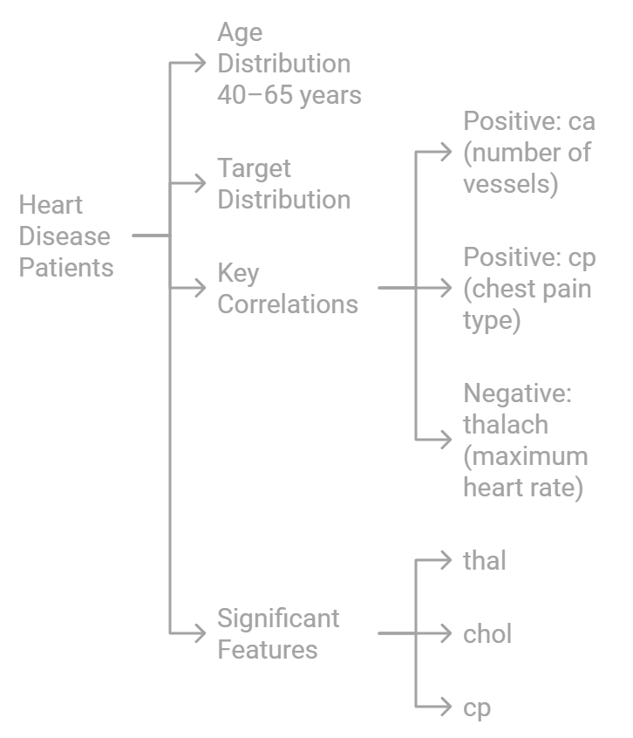
Exploratory Data Analysis (EDA)
Age distribution and trends:
Most patients fall between 40–65 years.
Target distribution:
Balanced dataset (~50% with heart disease).
Key correlations:
Positive: ca (number of vessels), cp (chest pain type).
Negative: thalach (maximum heart rate).
Observations:
Features like thal, chol, and cp play significant roles in prediction.

Slide 8
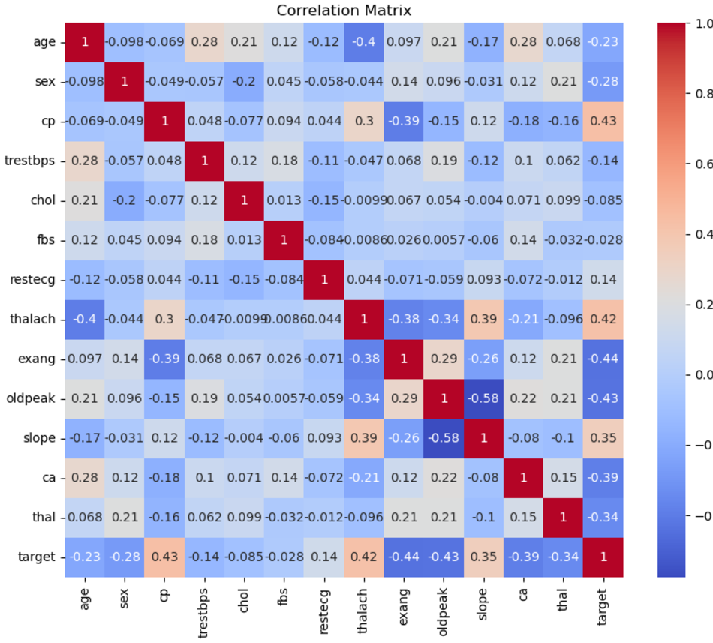
Correlation matrix
Variables positively correlated with target:
cp (chest pain type) (0.43) and thalach (maximum heart rate achieved) (0.42) are strongly positively correlated with the target variable, likely indicating their importance in predicting heart disease.
Variables negatively correlated with target:
exang (exercise-induced angina) (-0.44), ca (number of major vessels) (-0.39), and oldpeak (ST depression induced) (-0.43) have significant negative correlations with the target.
Age and target:
There is a weak negative correlation (-0.23), suggesting age may not have a strong linear relationship with the target in this dataset.

Slide 9
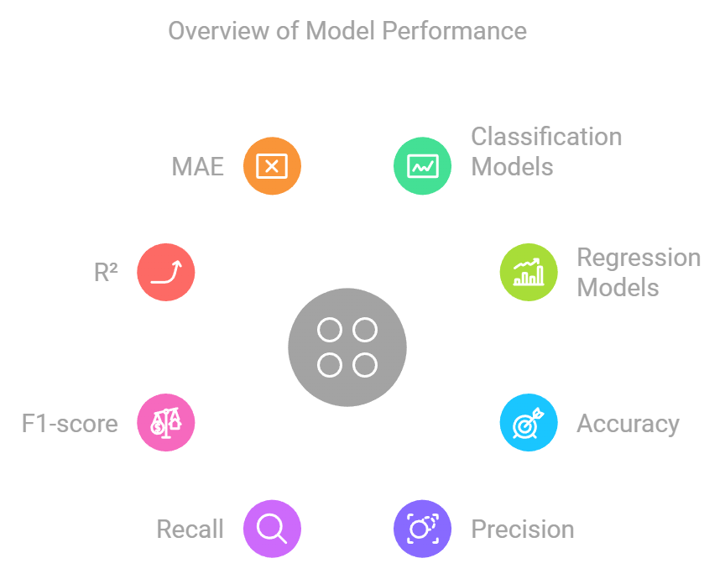
Model Development & Performance
Models implemented:
Classification: Logistic Regression, Random Forest.
Regression: Random Forest Regressor.
Model performance metrics:
Classification:
Accuracy, Precision, Recall, F1-score for each model.
Highlight best-performing model (e.g., Random Forest).
Regression:
R² (variance explained), MAE (Mean Absolute Error), MSE (Mean Squared Error).

Slide 10
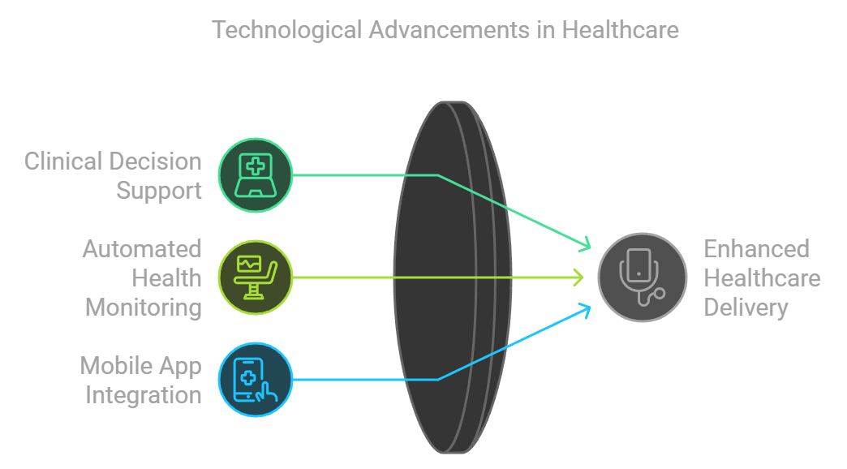
Applications
Real-world applications:
Clinical decision support systems for doctors.
Automated health monitoring for at-risk patients.
Integration into mobile apps or wearable devices for real-time tracking.

Slide 11
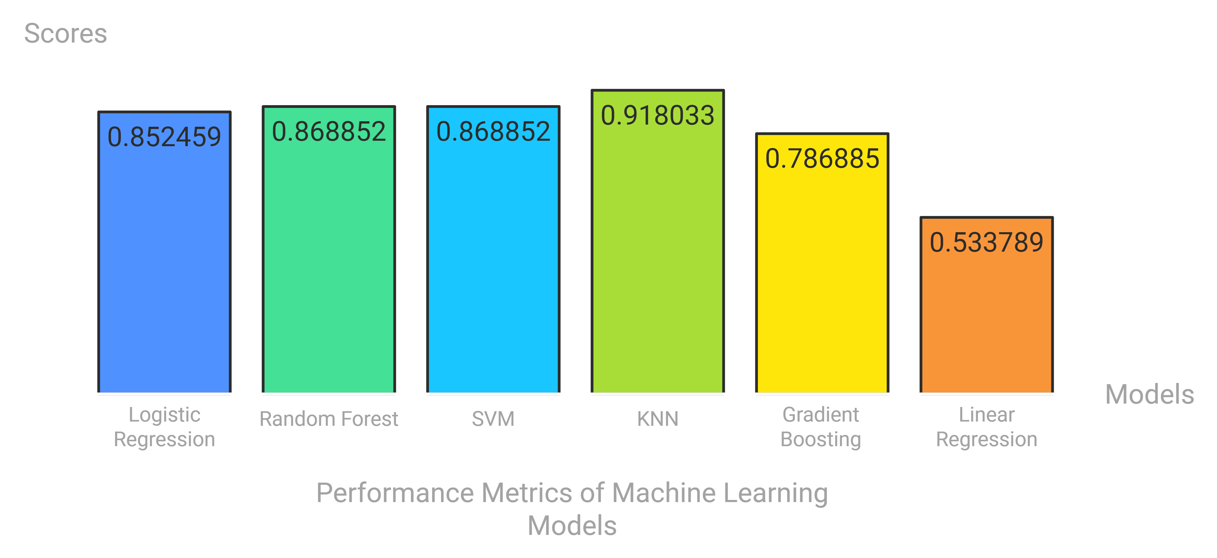
Results

Slide 12
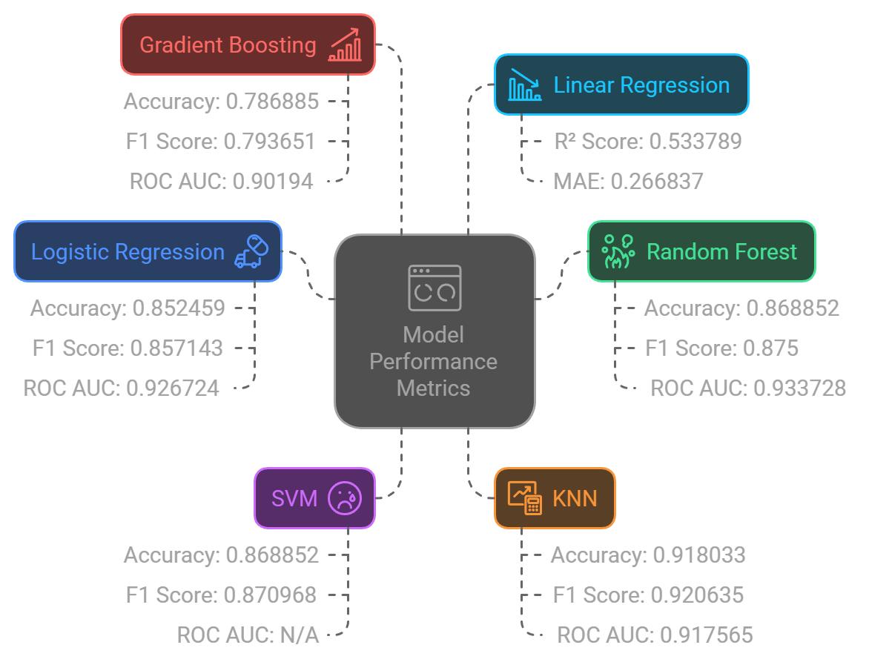
Results

Slide 13
THANKS!

